Slide 1


Institute of Emerging Careers
Global Superstore Sales
PRESENTATION
Presented by
Guided by
MUHAMMAD SAEED
SIR AFROZ
MARIYA HAREEM

Slide 2
GLOBAL SUPERSTORE SALE

Slide 3
PROJECT INTRODUCTION: Project Title: Sales Analysis for Global Superstore Objective: The objective of this project is to analyze sales data to identify loss-making products and develop strategies to improve profitability Background: Global Superstore is a retail company that sells various products across different regions. Understanding sales performance and profitability is crucial for making informed business decisions Scope: This project focuses on analyzing sales data, identifying trends, and finding loss-making products. It includes data cleaning, processing, and visualization to draw meaningful insights

Slide 4
Order ID: Unique identifier for each order placed.
Order Date: Date when the order was placed.
Ship Date: Date when the order was shipped.
Ship Mode: Shipping mode chosen for delivery (e.g., Standard Class, Express).
Customer ID: Unique identifier for each customer.
Customer Name: Name of the customer who placed the order.
Segment: Market segment to which the customer belongs (e.g., Consumer, Corporate).
Postal Code: Postal code of the customer's address.
City: City where the customer is located.
State: State where the customer is located.
Country: Country where the customer is located.
Region: Geographical region where the order was placed.
Market: Market to which the order belongs (e.g., APAC, EMEA).
Product ID: Unique identifier for each product.
Category: Broad category of the product (e.g., Furniture, Office Supplies, Technology).
Sub-Category: Detailed sub-category of the product (e.g., Chairs, Phones, Binders).
Product Name: Name of the product ordered.
Sales: Total sales revenue generated from the order.
Attributes:

Slide 5
Quantity: Number of units ordered. Discount: Discount applied to the order. Profit: Profit generated from the order. Shipping Cost: Cost incurred for shipping the order. Order Priority: Priority level assigned to the order (e.g., High, Medium, Low). Average Delivery Day: Average delivery days for each order. Person: Identifier or name of the person associated with the order or transaction. Return: Indicator showing whether the order was a return or not (e.g., Yes/No, True/False).
Attributes:

Slide 6
Objectives for Global Superstore Sales Data Analysis:
Increase Sales Performance
Improve Profitability
Enhance Customer Segmentation
Streamline Shipping and Delivery
Enhance Customer Experience
Maximize Customer Retention
Identify Risks

Slide 7

Dataset Summary
The Global Superstore sales analysis reveals key insights into regional sales performance, profitability, and customer segments. It identifies top-performing and underperforming products and evaluates shipping efficiency.

Slide 8
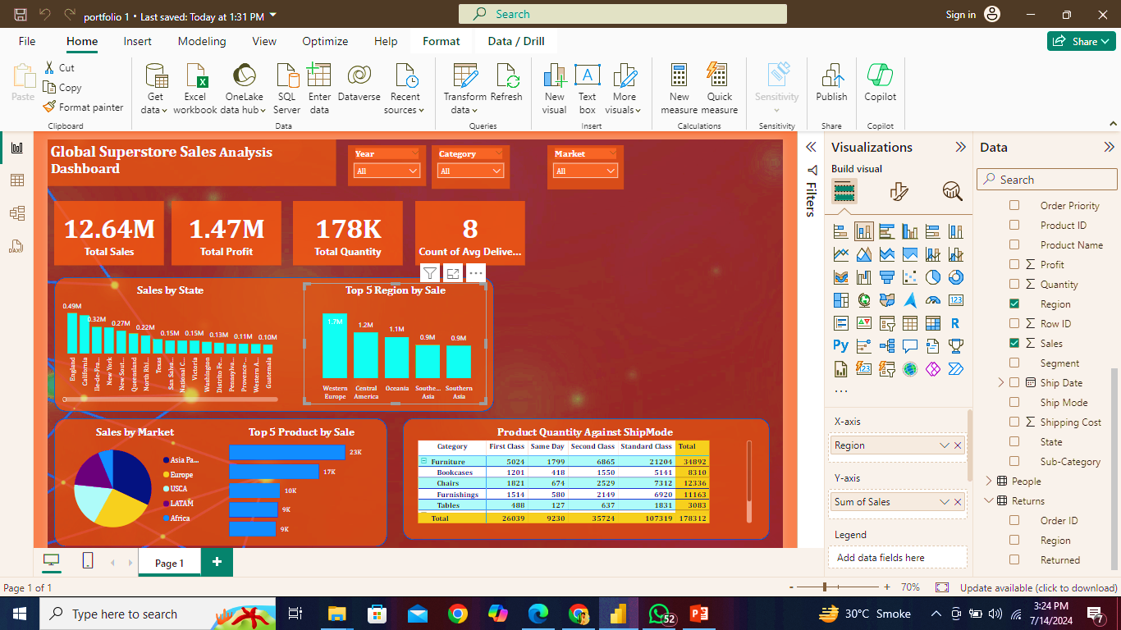
Total Sales:

Slide 9

Total Profit against Order:

Slide 10
Total Quantity of each product:

Slide 11
Average delivery in a days:

Slide 12
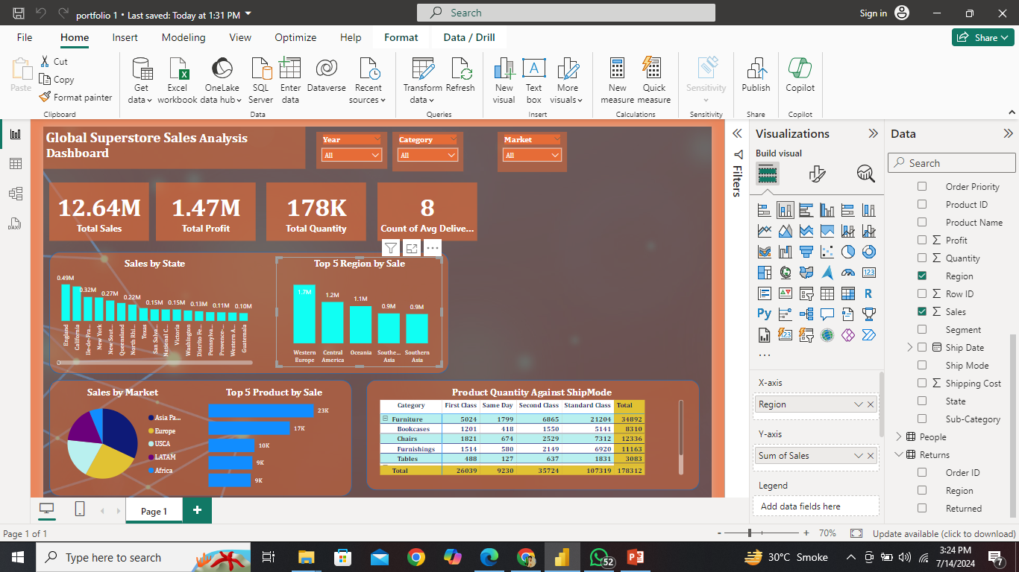
Top Product BY sales:

Slide 13
product quantity by Against Ship Mode:

Slide 14
TOP REGION BY SALES:

Slide 15
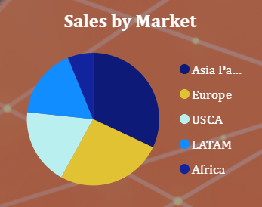
Sales by Market:

Slide 16
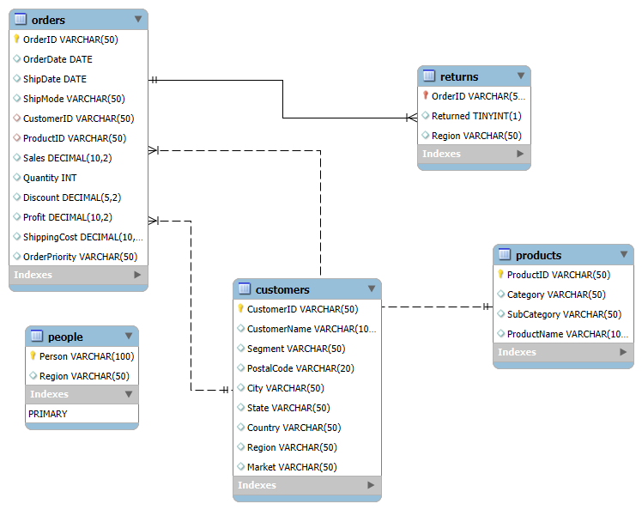
Data Modeling

Slide 17
Recommendation:
Top Sales by Market
Top Region by Sale
Products Quantity Against Ship Mode
Top Products by Sale
Shipping Mode Impact on Delivery Times
Top Sales Product Categories
Highest Sales Regions
Average Shipping Costs

Slide 18
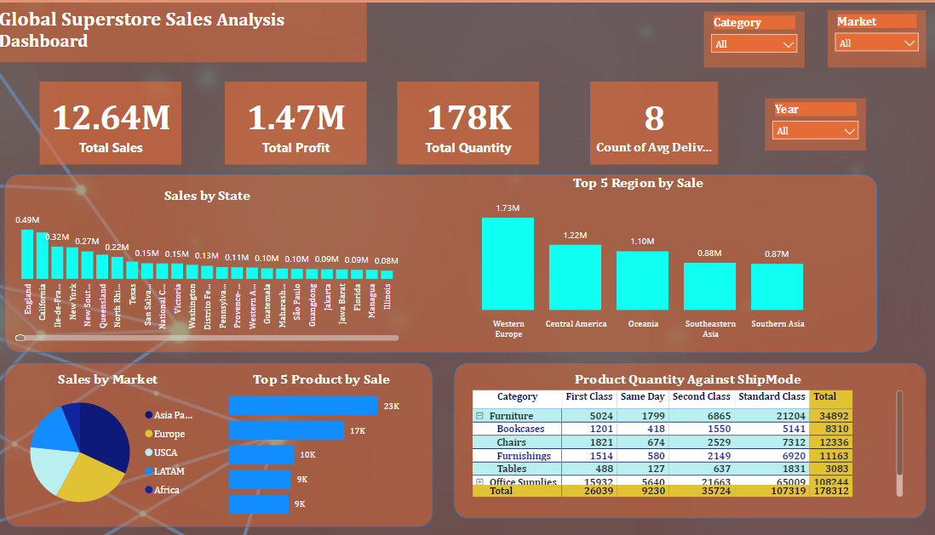
Dashboard:

Slide 19
THANKS

